Slide 1
Welcome to hosa
11/5/2014

Slide 2
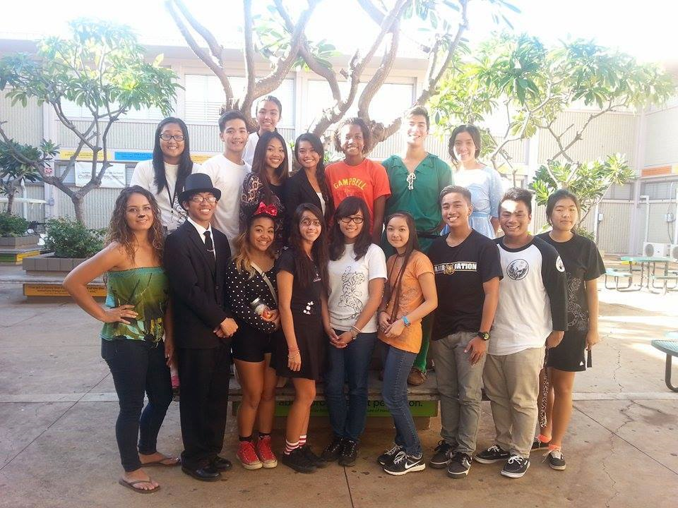
Thank you everyone who came on Friday!

Slide 3
MOST VOTED PIN DESIGN FOR OUR CHAPTER
Volcano
With 10 Votes

Slide 4
REGISTRATION INFORMATION FOR HOSA CONFERENCE (FEB 10th-11th)
Registration
Forms are due November 21st
Registration Fee: $85
Due Date: December 10th

Slide 5
Lead to inspire workshop
First come first serve basis
Own transportation
Last day to sign up is November 14

Slide 7
Reasons to go
Opportunity to meet members from other chapters
Opportunity to meet HOSA State Advisor and Officers
Gain leadership and team building skills
For 9th and 10th graders : HAWAII HOSA IS LOOKING FOR POTENTIAL STATE OFFICER CANDIDATES!

Slide 8
Have you been checking out the EVENTS / event guidelines?
Have your 3 events list or final event choice
Figure out what event you would like to do for HOSA Conference
Flow Chart / Event List handout will help you
If you made a decision, inform an officer of your event choice
For further detail on a specific event, please see Shanell and Christian
Don’t have events with you today?
Take this time to figure out what events you would be interested in
Need to notify us of your final choice by November 14th

